Slide 1
COMP90054 AI Planning for Autonomy Workshop - 1

Slide 2

Chao Lei
Email: clei1@student.unimelb.edu.au
If you have any questions about the lecture or workshop, pls put them on (ED) Discussion Board.
https://colab.research.google.com/github/COMP90054/2024-S2-tutorials/blob/main/problem_set_01.ipynb

Slide 3
Why Planning
Industry
Amazon
https://aws.amazon.com/blogs/quantum-computing/optimization-of-robot-trajectory-planning-with-nature-inspired-and-hybrid-quantum-algorithms/
NASA
https://ai.jpl.nasa.gov/
Airbus
https://www.airbus.com/en/innovation/digital-transformation/artificial-intelligence
J.P. Morgan AI Research
IBM….
Conference:
ICAPS
AAAI
ICLR
ICML
Neurips
https://icaps25.icaps-conference.org/

Slide 4
Objectives of today’s workshop:
Question 1: State Model
Question 2: Blind Search Algorithm: BFS, DFS, ID

Slide 5
Blind Search Algorithms :
Only use the basic ingredients for general search algorithms.
Depth First Search (DFS)
Breadth-first search (BrFS)
Uniform Cost (Dijkstra)
Iterative Deepening (ID)
Heuristic Search Algorithms :
Additionally use heuristic functions which estimate the distance (or remaining cost) to the goal.
A*
WA*
Hill Climbling
Greedy Best First Search

Slide 6
Properties
Optimality
Are the returned solutions guaranteed to be optimal?
Completeness
Is the strategy guaranteed to find a solution when there is one?
Sound
Is the algorithm guaranteed to return correct answers?

Slide 7
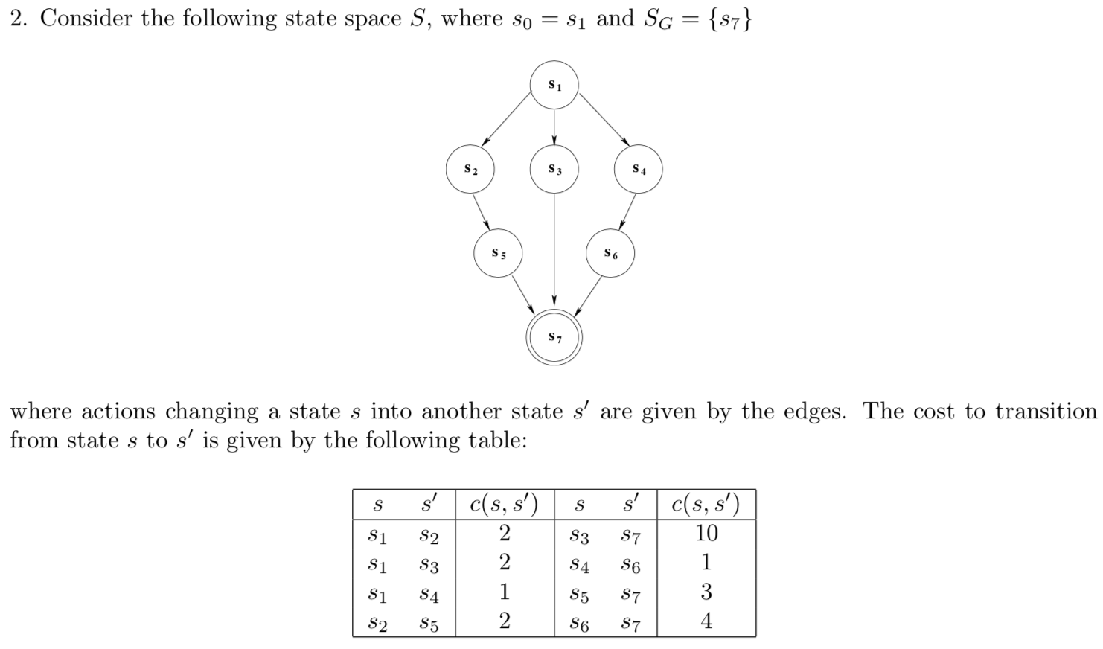
initial state
2
2
1
2
1
10
3
4
goal state

Slide 8
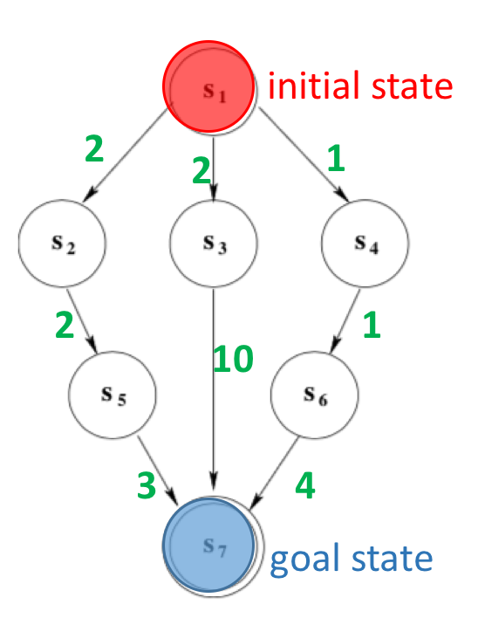
1.BFS
n3 = ⟨ s3, g(n), n_{parent} ⟩
Ordered Sequence of States expanded
n1 = < s1, 0, -- >
n2 = < s2, 2, n1 >
n3 = < s3, 2, n1 >
n4 = < s4, 1, n1 >
n5 = < s5, 4, n2 >
n6 = < s7, 12, n3 >
The solution found by BFS: s1 -> s3 -> s7
The solution is not optimal
BFS will be optimal if the costs are uniform, e.g. all costs are 1

Slide 9
2. DFS
Any one of 3 possible solutions:
s1 -> s2 -> s5 -> s7 cost = 2 + 2 + 3 = 7
s1 -> s3 -> s7 cost = 2 + 10 = 12
s1 -> s4 -> s6 -> s7 cost = 1 + 1 + 4 = 6
DFS can not guarantee optimality

Slide 10
3. Iterative Deepening
depth bound= 0
Depth = 0
Depth = 1
 | 1st stage | 2nd stage
Open
Closed
n1 = < s1, 0, -- >
Depth = 2
n1 = < s1, 0, -- >
Depth = 3
Ordered Sequence of States expanded

Slide 11
3. Iterative Deepening
depth bound= 1
Depth = 0
 | 1st stage | 2nd stage | 3rd stage
Open
Closed
Depth = 1
n1 = < s1, 0, -- >
n2 = < s2, 2, n1 >
n3 = < s3, 2, n1 >
Depth = 2
n4 = < s4, 0, n1 >
n1 = < s1, 0, -- >
n1 = < s1, 0, -- >
Depth = 3
n2 = < s2, 2, n1 >
n3 = < s3, 2, n1 >
n4 = < s4, 0, n1 >
Ordered Sequence of States expanded

Slide 12
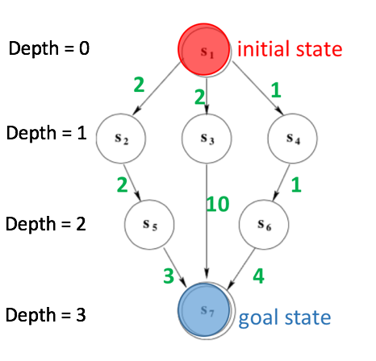
3. Iterative Deepening
depth bound= 2
 | 1st stage | 2nd stage
Open
Closed
n1 = < s1, 0, -- >
n2 = < s2, 2, n1 >
n3 = < s3, 2, n1 >
n4 = < s4, 0, n1 >
n1 = < s1, 0, -- >
 | 3rd stage | 4th stage | 5th stage
Open
Closed
n3 = < s3, 2, n1 >
n3 = < s3, 2, n1 >
n4 = < s4, 0, n1 >
n4 = < s4, 0, n1 >
n4 = < s4, 0, n1 >
n6 = < s7, 0, n3 >
n5 = < s5, 4, n2 >
n1 = < s1, 0, -- >
n1 = < s1, 0, -- >
n1 = < s1, 0, -- >
n2 = < s2, 2, n1 >
n2 = < s2, 2, n1 >
n2 = < s2, 2, n1 >
n5 = < s5, 4, n2 >
n5 = < s5, 4, n2 >
n3 = < s3, 2, n1 >

Slide 13
depth bound= 2
 | 1st stage | 2nd stage
Open
Closed
n1 = < s1, 0, -- >
n2 = < s2, 2, n1 >
The solution found by ID:
s1 -> s3 -> s7
n3 = < s3, 2, n1 >
n4 = < s4, 0, n1 >
n1 = < s1, 0, -- >
3rd stage | 4th stage | 5th stage | 6th stage
n3 = < s3, 2, n1 >
n3 = < s3, 2, n1 >
n4 = < s4, 0, n1 >
n4 = < s4, 0, n1 >
n4 = < s4, 0, n1 >
n4 = < s4, 0, n1 >
n6 = < s7, 0, n3 >
n5 = < s5, 4, n2 >
n1 = < s1, 0, -- >
n1 = < s1, 0, -- >
n1 = < s1, 0, -- >
n1 = < s1, 0, -- >
n2 = < s2, 2, n1 >
n2 = < s2, 2, n1 >
n2 = < s2, 2, n1 >
n2 = < s2, 2, n1 >
n5 = < s5, 4, n2 >
n5 = < s5, 4, n2 >
n5 = < s5, 4, n2 >
n3 = < s3, 2, n1 >
n3 = < s3, 2, n1 >
n6 = < s7, 0, n3 >
Ordered Sequence of States expanded

Slide 14
The solution found by Iterative Deepening:
s1 -> s3 -> s7
The solution is not optimal
ID will be optimal if the costs are uniform, e.g. all costs are 1

Slide 15
Adapt BFS to account for g(n)
Dijkstra’s Algorithm
(also known as Uniform Search)
Like BrFS but expanding the node with lowest accumulated cost, instead of the lowest length, where length is defined over the number of traversed arcs.

Slide 16
State Model
• State space S • Initial state s₀ ∈ S • Set of goal states s_{G} ⊆ S
• Applicable actions function A(s) for each state s ∈ S
• Transition function f (s, a) for s ∈ S and a ∈ A(s) • Cost of each action c(a, s) for s ∈ S and a ∈ A(s)

Slide 17
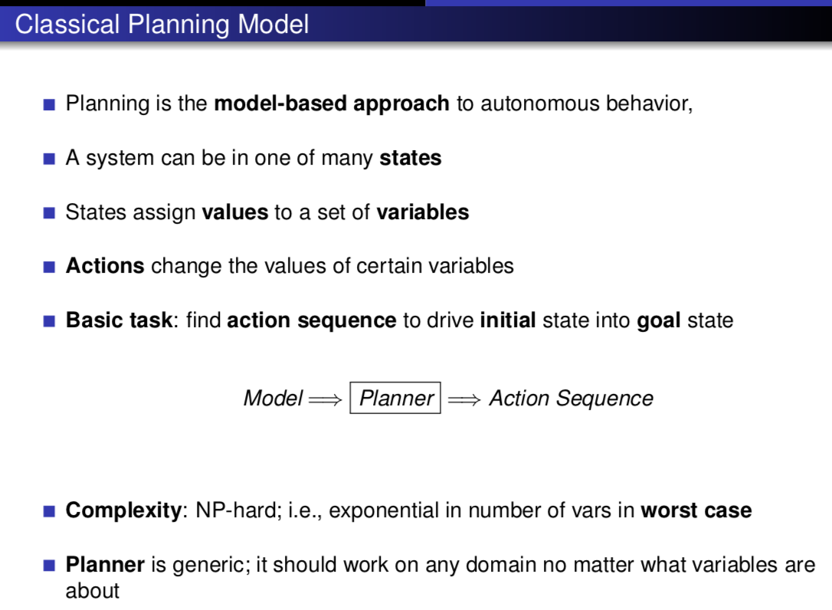

Slide 18
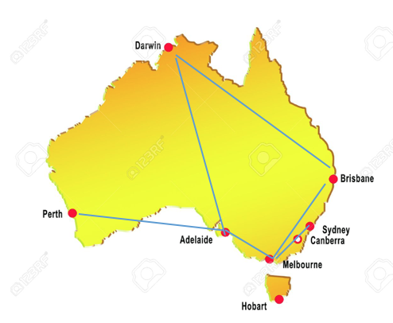
Travelling Salesman Problem
Consider:
A set of cities V to visit in any order
A starting city location v_{start}
A set of edges E specifying if there is an edge between two cities <v, v’>
State space
{Current city, Visited cities}

Slide 19



State space
{Current city, Visited cities}
Travelling Salesman Problem
Initial State
Applicable actions function
Cost of each action
Transition function
Goal State

Slide 20
8-Puzzle Problem
2 | 4 | 1
5 | 6
3 | 7 | 8
1 | 2 | 3
4 | 5 | 6
7 | 8
Initial state
Goal state
Moves: up, down, left, right

Slide 21
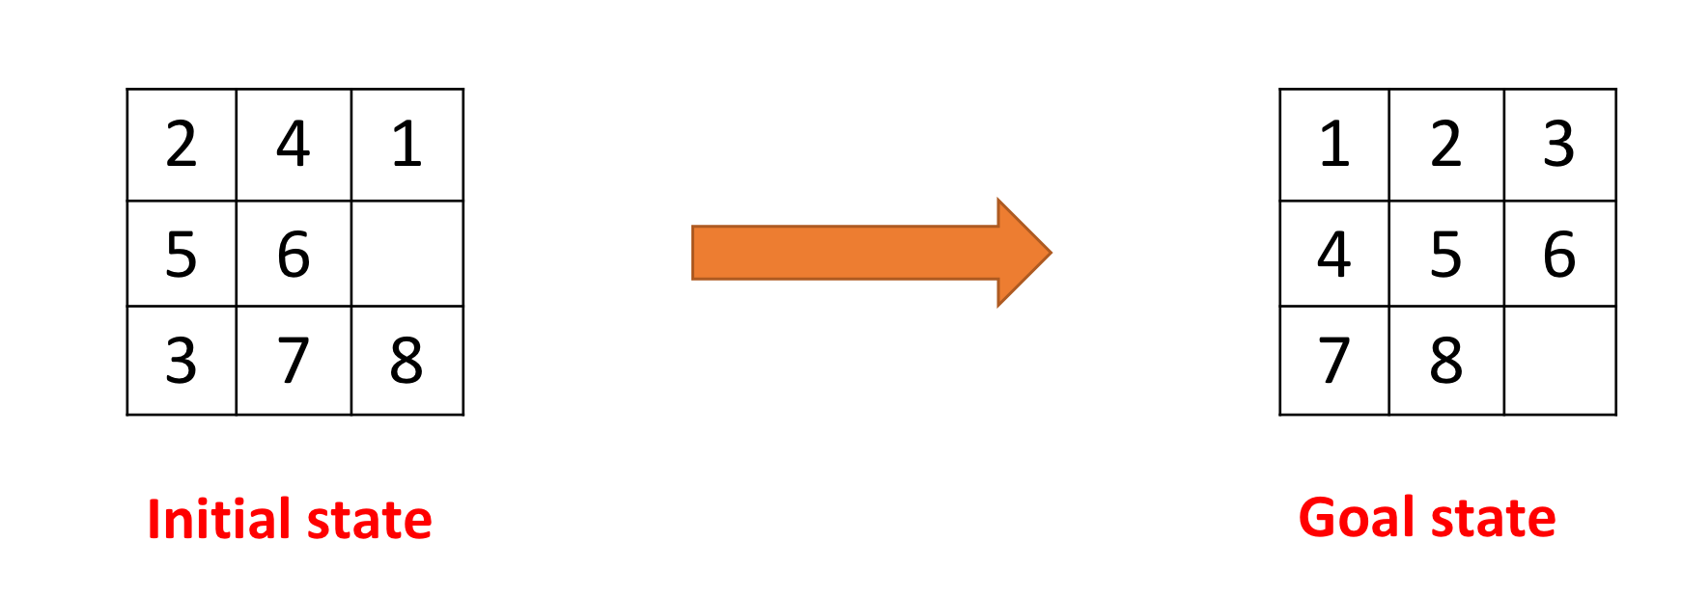
Initial state:
s0 = {2,4,1,5,6,_,3,7,8}
Goal state:
s0 = {1,2,3,4,5,6,7,8,_}

